Slide 1

Attitudes and stereotypes: Function of attitudes
AEPSY Year 11 ATAR Psychology

Slide 2
Learning Intentions
Attitudes and stereotypes
function of attitudes – implicit and explicit

Slide 3
Success Criteria
Define attitude
Define stereotype
Define explicit attitude and give examples
Define implicit attitude and implicit bias and give examples

Slide 4


Slide 5
Questions
What is attitude?
How are attitudes formed?
What is a stereotype?
How are stereotypes formed?

Slide 6
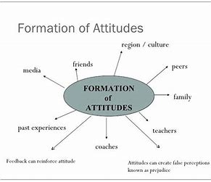

Slide 7
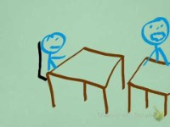

Slide 8
Questions
5. What is explicit attitude? Give an example.
6. What is implicit attitude? Give an example.
7. What are the problems with implicit attitude and implicit bias?
8. How can we reduce implicit bias?

Slide 9
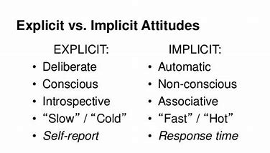

Slide 11
Success Criteria
Define attitude
Define stereotype
Define explicit attitude and give examples
Define implicit attitude and implicit bias and give examples

